Slide 1
A sneak peek into Belgium’s real estate industry
Muhammad Anhar Firdausyi
BeCode - Junior

Slide 2
Project execution strategy
Web Scraping
Data storage
Data Analysis

Slide 3
Things to look at
Price​
Location
Other features:
Size of plot area (NL: Verkaveling)
​Room Count
Toilet Count
Bedroom Count
Bathroom Count

Slide 4
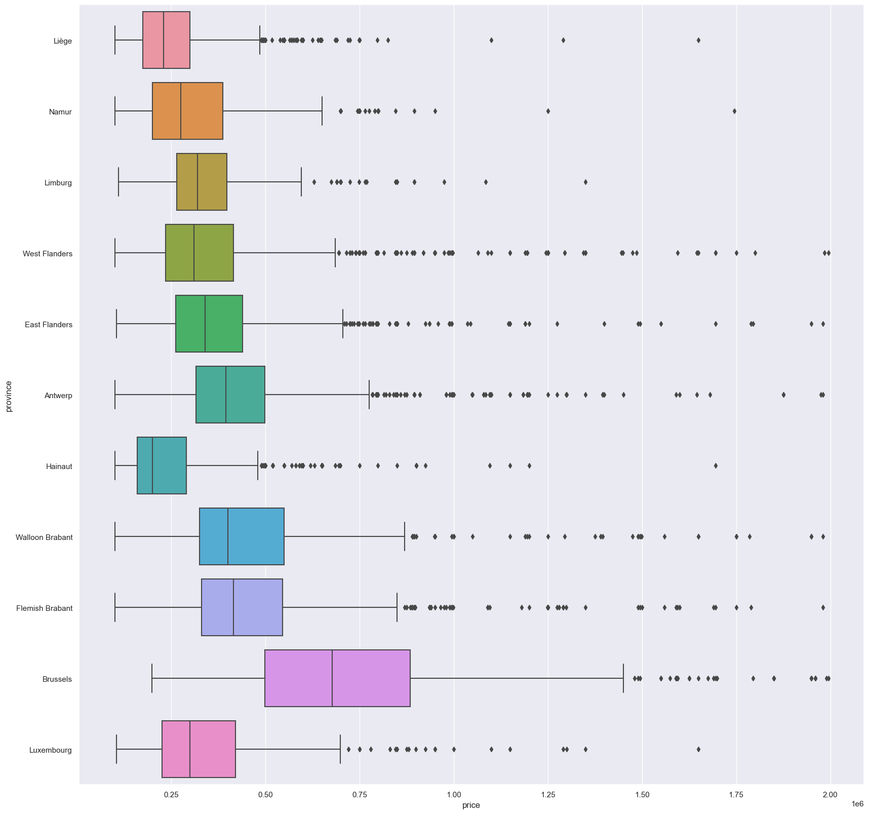
Price – location residential houses

Slide 5
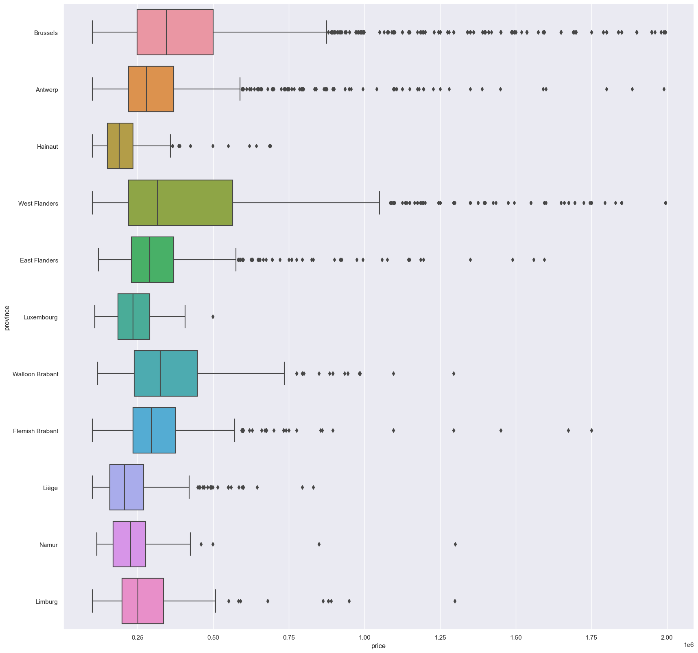
Price – location residential apartments

Slide 6
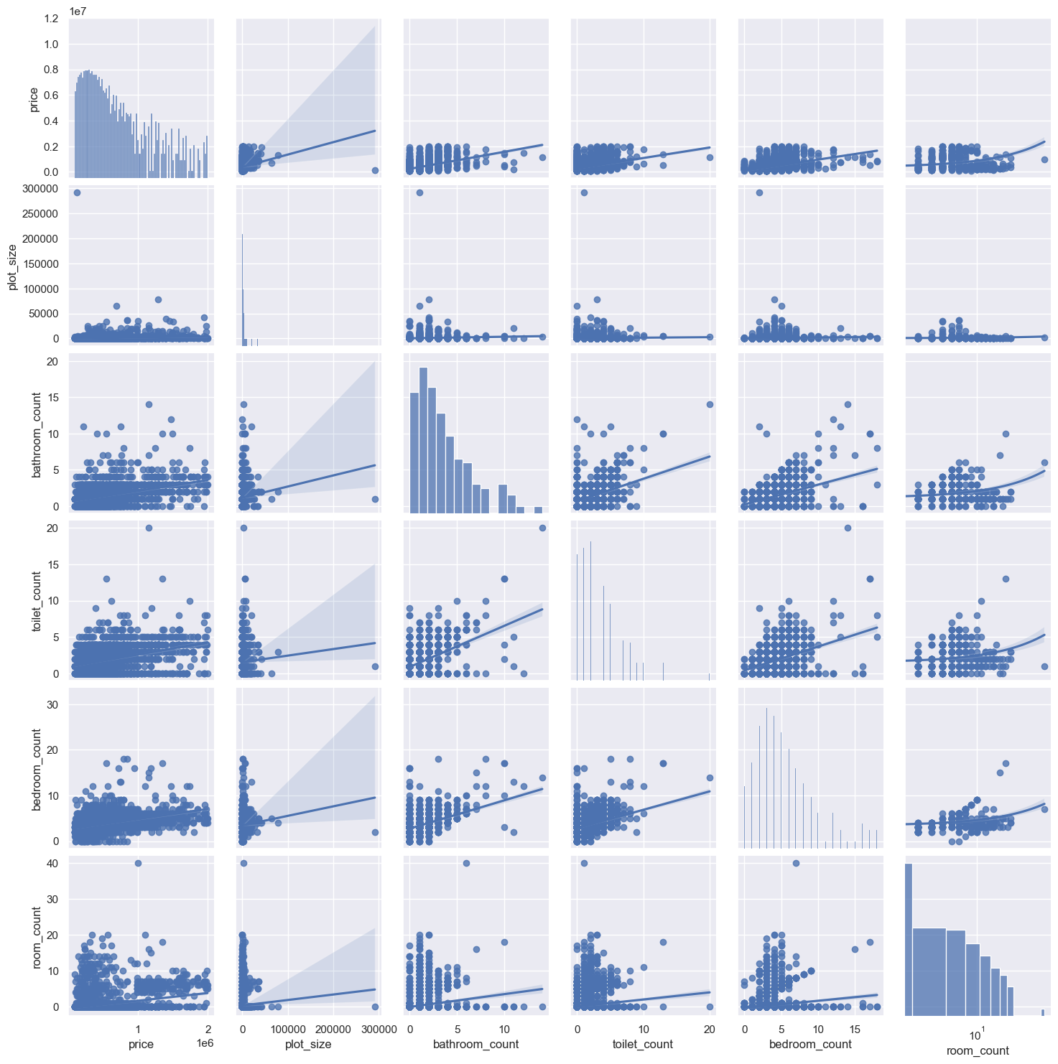
What other factors should I LOOK AT while buying a house?

Slide 7
SUMMARY
You get what you pay for, until you don’t.
There are externalities that influence the way different types of properties is valued
Data collection strategy is crucial in order to generate dependable dataset.

Slide 8
THANK YOU
Muhammad Anhar Firdausyi
https://github.com/mfirdaus354
muhammad.anhar.firdausyi@gmail.com

